Slide 1
Efficient Memory Management Algorithm Design

Slide 2
Agenda
Introduction
Problem Statement
Project Objectives
Proposed Algorithm Design
Implementation Details
Code Overview
Performance Results
Conclusion

Slide 3
Introduction
Importance of Memory Management
Key for system performance and resource optimization
Mitigates risks like memory leaks and system crashes
Objective: Design and implement an efficient memory management algorithm

Slide 4
Problem Statement
Despite significant advancements in computing technology, memory management remains a pervasive challenge.
Particularly problematic in environments with dynamic workloads and resource constraints.
Traditional algorithms (First Fit, Best Fit) fall short in:
Effectively optimizing memory utilization.
Minimizing fragmentation.
Handling variable-sized memory allocations and deallocations.
Proliferation of cloud computing, edge computing, and IoT devices increases demand.
Diverse environments impose unique requirements and constraints.
Need for adaptable and scalable memory management strategies.
Project Goal:
Balance performance, scalability, and resource efficiency.
Optimize memory utilization across various environments.

Slide 5
Project Objectives
Optimize Memory Usage
Minimize Fragmentation
Enhance System Performance
Ensure Reliability and Scalability
Provide Flexibility

Slide 6
Proposed Algorithm Design
Memory Allocation Strategies: Implements First Fit, Best Fit, and Worst Fit algorithms.
Concurrency Control: Uses pthread_mutex_t to ensure thread safety during memory allocation and deallocation.
Memory Reclamation: Includes functions to deallocate memory and coalesce free memory blocks.
Performance Measurement: Measures and compares the performance of different allocation strategies.
Initialization and Cleanup: Properly initializes and frees the memory allocator.

Slide 7
Implementation Details
Languages: Implemented in C for efficiency and low-level system access
Key Functions:
allocateMemory: Allocates memory using First Fit, Best Fit, or Worst Fit strategies.
deallocateMemory: Frees allocated memory blocks to prevent memory leaks.
coalesceMemory: Merges adjacent free blocks to reduce fragmentation.
printMemoryBlocks: Displays block information for debugging and monitoring.
Performance Measurement:
Measures time for allocation and deallocation.
Compares performance of different strategies.

Slide 8
Code Overview
Structure and Components:
Main Functions
Data Structures
Concurrency Control
Error Handling
Code Flow:
Initialization
Allocation Process
Deallocation Process
Debugging and Monitoring

Slide 9
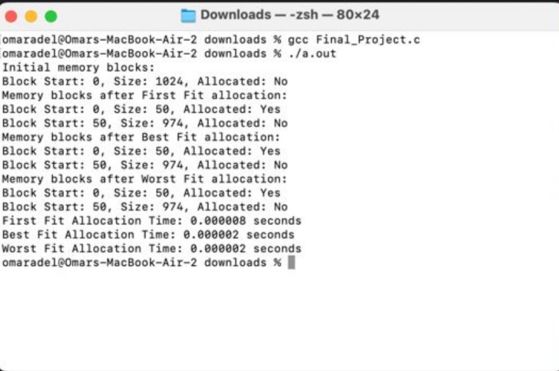
Code Results

Slide 10
conclusion
Summary of Achievements:
Successfully designed and implemented a novel memory management algorithm.
Achieved optimization of memory usage and minimization of fragmentation.
Enhanced system performance through efficient memory allocation and deallocation.
Ensured the algorithm's reliability and scalability across various computing environments.
Provided flexibility to meet diverse application requirements and memory usage patterns.
Future Prospects:
Potential for further optimization through advanced techniques like memory compression and predictive allocation.
Exploration of integration with other system components to enhance overall system efficiency.
Final Thoughts:
The project represents a significant advancement in memory management techniques, addressing contemporary challenges and setting the foundation for future developments.
Comprehensive planning, meticulous design, and robust implementation were key to achieving the project's objectives.
Emphasizing the importance of documentation, deployment, and ongoing support ensures the algorithm's long-term effectiveness and adaptability.

Slide 11
THANK YOU
Abdelrahman Abdelmoneim – 211001829
Ahmed wael - 211000770
Ahmed hamdy Mahmoud - 211001737
Omar adel gamal - 202001270
Fady Amgad - 211001915

